Slide 1



A PRESENTATION BY,
INNOWAYSHINE
PAVAN.K (Leader)
SURYA PRATAP SINGH.R
ROSHINI.S

Slide 2
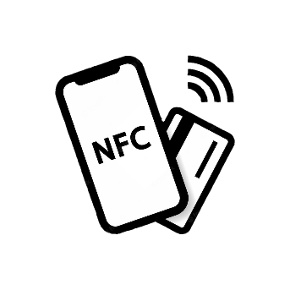
- PROXIFIER
(Compact and reliable medium for NFC operations)
Proxifier acts as a medium which performs all the necessary operations of NFC (Near Field Communication) technology. Our vision is to make people more aware about the existence of NFC technology, which is accomplished by using our platform. Using this platform, people can perform certain day to day activities with ease.

Slide 3
PROXIFIER - an nfc based application
SMART FILE SHARING
DAY TO DAY FEATURES
KEY PURPOSES
LESS VULNERABLE
SECURED TRANSACTION

Slide 4
INDEX:
SMART FILE SHARING
SECURED TRANSACTION
ADDITIONAL FEATURES
USER CUSTOMIZABLE
FUTURE BUSINESS

Slide 5
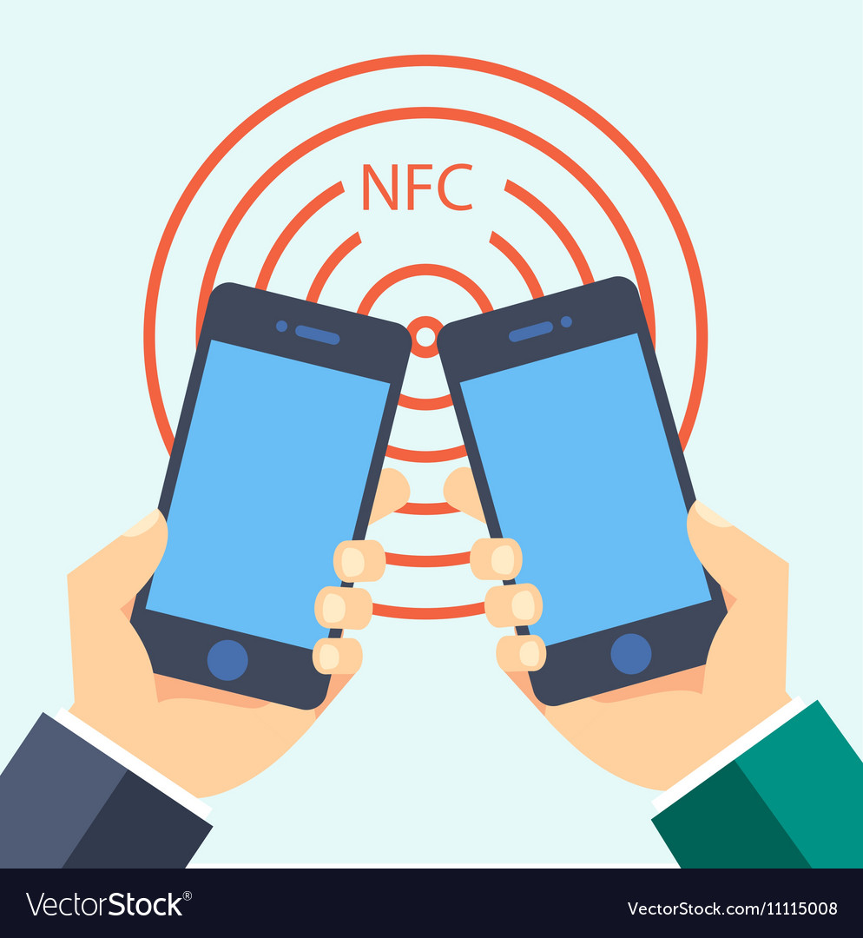
SMART FILE SHARING:
SO FAR, IT WAS IMPOSSIBLE TO TRANSFER LARGE FILES THROUGH NFC BECAUSE OF ITS LOW SPEED RATE.
BUT OUR PLATFORM MAKES IT EASIER BY USING NFC TO PAIR TWO DEVICES AND FURTHER IT USES WIFI-DIRECT TO TRANSFER LARGE FILES IN A MATTER OF SECONDS.
EARLIER PEOPLE USED CHINESE APPLICATIONS LIKE SHARE-IT WHICH NOT ONLY INVOLVED MULTIPLE STEPS BUT ALSO THREATENED OUR PRIVACY.
BUT NOW, PROXIFIER MAKES IT WAY MORE EASIER WITH MINIMUM STEPS AND MAXIMUM PROTECTION.

Slide 6
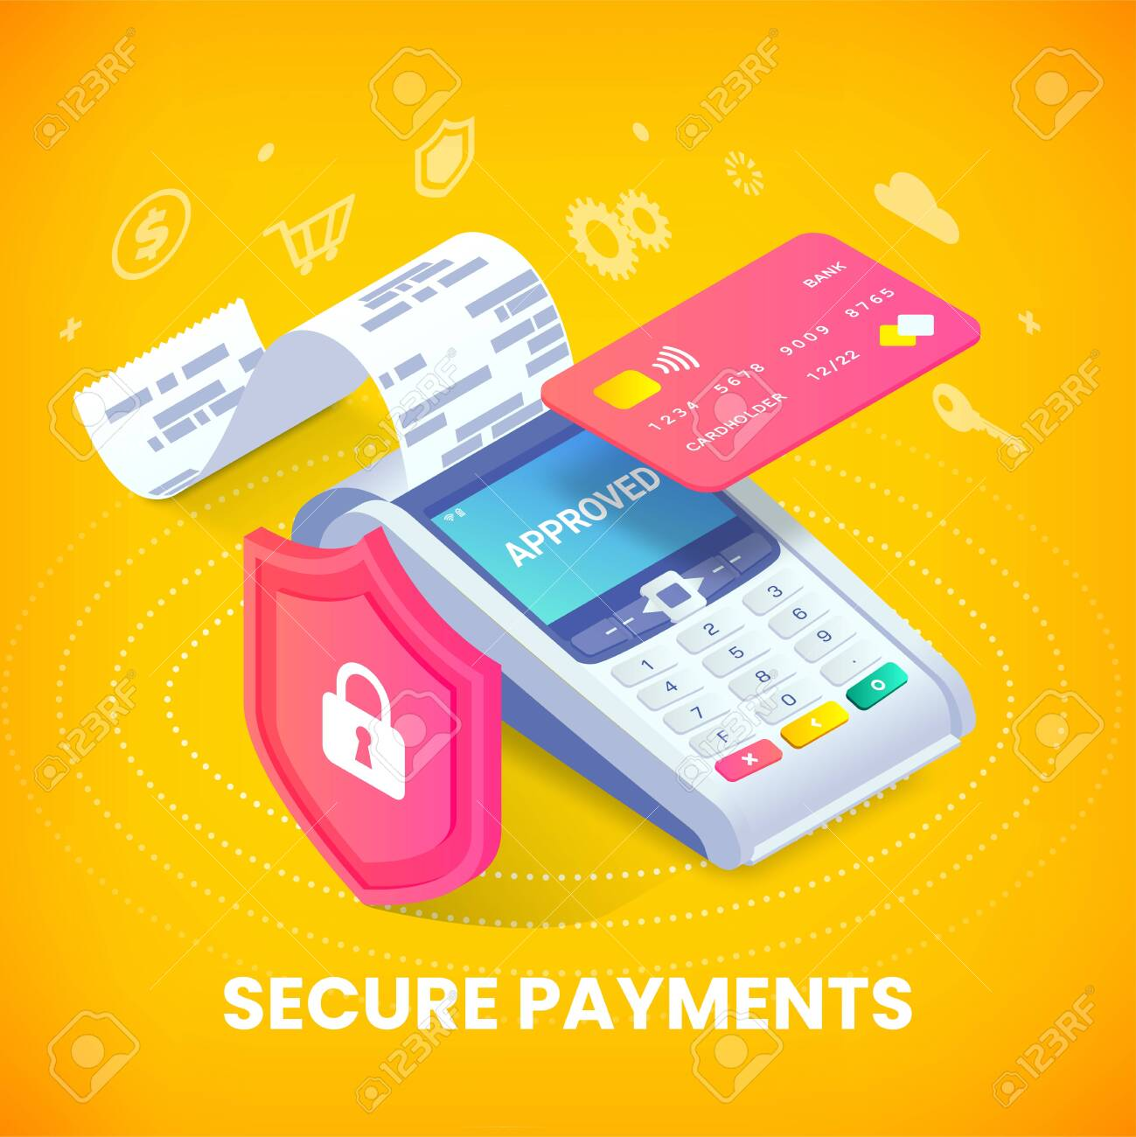
SECURED TRANSACTION:
IN GENERAL NFC BASED TRANSACTIONS ARE NOT USUALLY ENCOURAGED BECAUSE OF ITS LOW SECURITY.
BUT OUR PLATFORM VERIFIES THE BIOMETRICS OF THE USER WHENEVER A TRANSACTION IS PERFORMED.
THIS RESULTS IN MAKING NFC BASED TRANSACTIONS LESS VULNERABLE TO HACKERS.
IT FUTHER MAKES IT MORE COVENIENT WHEN COMPARED TO TRADITIONAL CARD AND UPI BASED TRANSACTIONS.

Slide 7


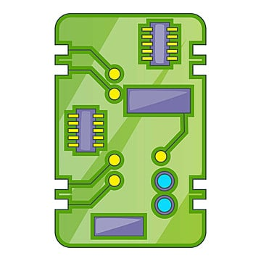
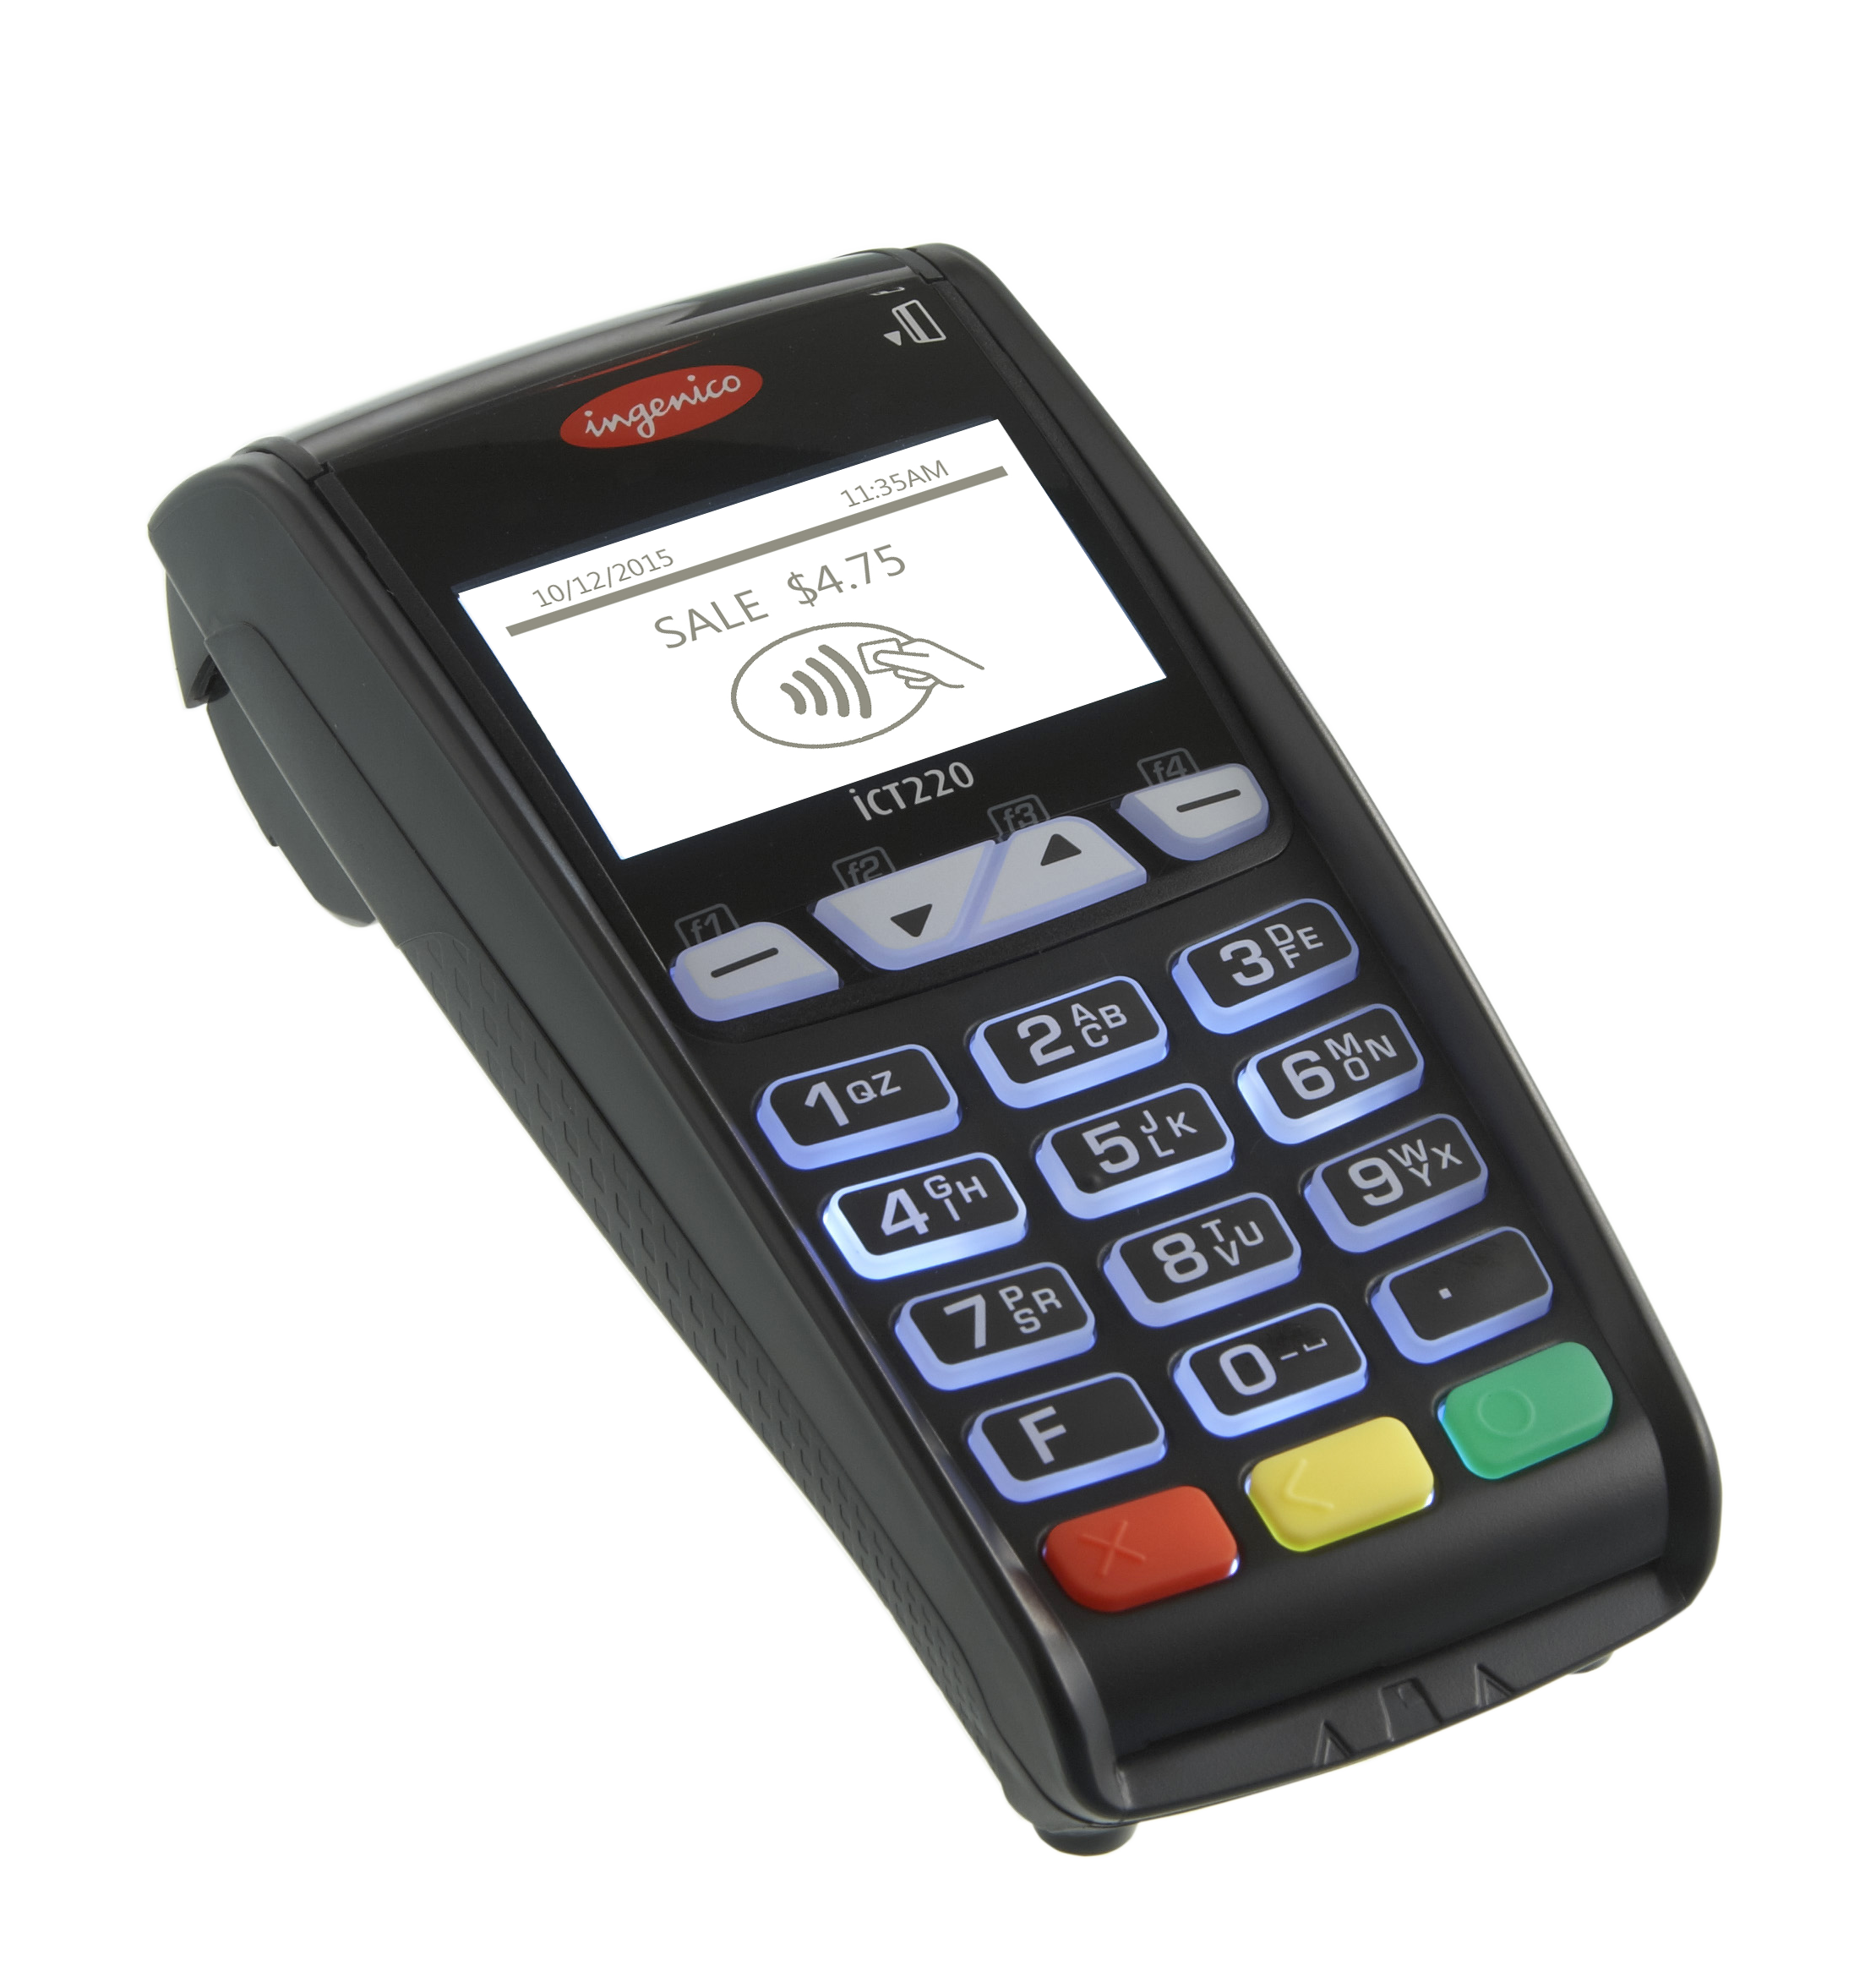


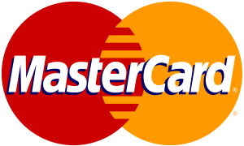


ARCHITECTURE OF PROXIFIER
Cellular system
Internet
Encryption Module
Mobile Circuit
POS
Terminal
Issuer Bank
Payment Components
Centralized Payment Processing Network
Payment Interface
NFC
Module
Fingerprint Authentication
Acquirer Bank

Slide 8
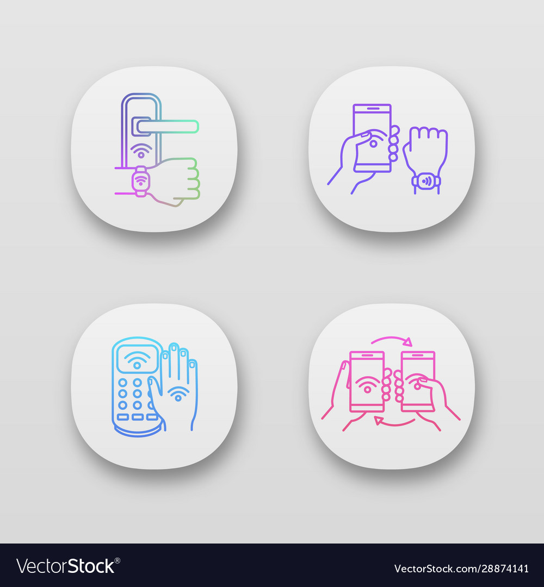
DAY TO DAY FEATURES:
APART FROM THE CORE FEATURES, PROXIFIER IS CAPABLE OF PERFORMING MULTIPLE DAY TO DAY ACTIVITIES.
SOME OF THEM ARE,
SETTING AN ALARM
ACCESSING THE DOOR LOCK
SHELVES - TALKING STORE
SHARING OUR VIRTUAL BUSINESS CARD
ACCESSING WIFI NETWORKS WITHOUT PASSCODE

Slide 9

USER CUSTOMIZABLE:
USERS ALWAYS CARVE FOR MORE FEATURES, DOESN’T MATTER HOW MANY OF THEM YOU PROVIDE.
AS A REMEDY, PROXIFIER COMES UP WITH A FEEDBACK SECTION WHERE USERS CAN CUSTOMIZE THEIR OWN FEATURES BY SENDING SUGGESTIONS TO THE DEVELOPER.
USERS ARE ALLOWED TO CUSTOMIZE THE PLATFORM’S INTERFACE AS PER THEIR REQUIREMENTS (i.e) OPTIONS SELECTED BY THE USERS WILL BE DISPLAYED ON THE MENU- DRIVEN INTERFACE.

Slide 10

FUTURE BUSINESS ASPECTS:
NFC HAS ALWAYS BEEN FAR MORE SUPERIOR WHEN COMPARED TO OTHER WIRELESS COMMUNICATION TECHNOLOGIES.
PEOPLE USED TO HAVE TRUST ISSUES WITH NFC BECAUSE OF ITS SECURITY ISSUES, AND IT DIDN’T GOT THE RECOGNITION WHICH IT DESERVED.
BUT WITH PROXIFIER WE CAN BRING BACK THE NFC TECHNOLOGY WITH MORE ADVANCEMENT AND EASEMENT.
AND HENCE NFC HAS A BRIGHT FUTURE WHEN BROUGHT IN BUSINESS BECAUSE OF ITS UNIQUENESS.

Slide 11
THANK YOU
&
HOPE YOU WILL ACCESS OUR
PLATFORM SOON…

